Slide 1

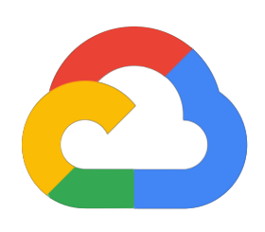
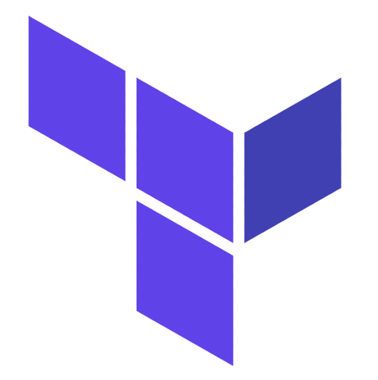
Terraform
Google Cloud Platform

Slide 2
COURSE INTRODUCTION
What is terraform?
What is Iac?
How terraform can be used to manage you infrastructure?
Terraform resources
Terraform variables & outputs
Terraform Modules
Terraform State
How to build infrastructure on GCP

Slide 4

OUR

Slide 5
THANK YOU

